Slide 1

Suicide ANALYSIS
BY- PARTH
SHARANJIT

Slide 2


End User

Slide 3
Analysis scope
The data covers 60 countries.
6 different age groups.
6 generations.

Slide 4
Different age groups covered
5-14 years
15-24 years
25-34 years
35-54 years
55-74 years
75+ years

Slide 5
Different generations
1900–1924
GI Generation
1925–1945
Traditionalist or Silent Generation
1946–1964
Baby Boomers
1965–1979
Thirteeners or Generation X
1980- Late90’s
Millennials or Generation Y
Late 90’s- 2010
Generation z or Centennials

Slide 6
Common reasons for suicide
Family history of depression
Anxiety disorders
Untreated depression
Unstable family experiences
Family history of members died by suicide

Slide 7
Contd..
Exposure to violence or abuse.
Lack of support network.
Emotional or physical abuse.
Feeling of distress.
Negative experiences.

Slide 8
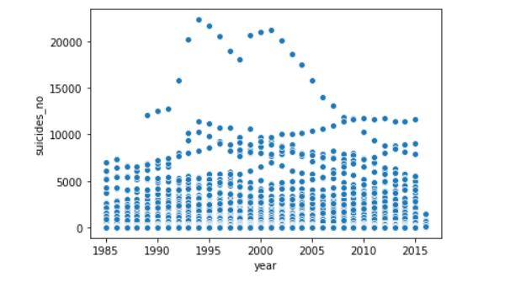
Some Graphical analysis

Slide 9
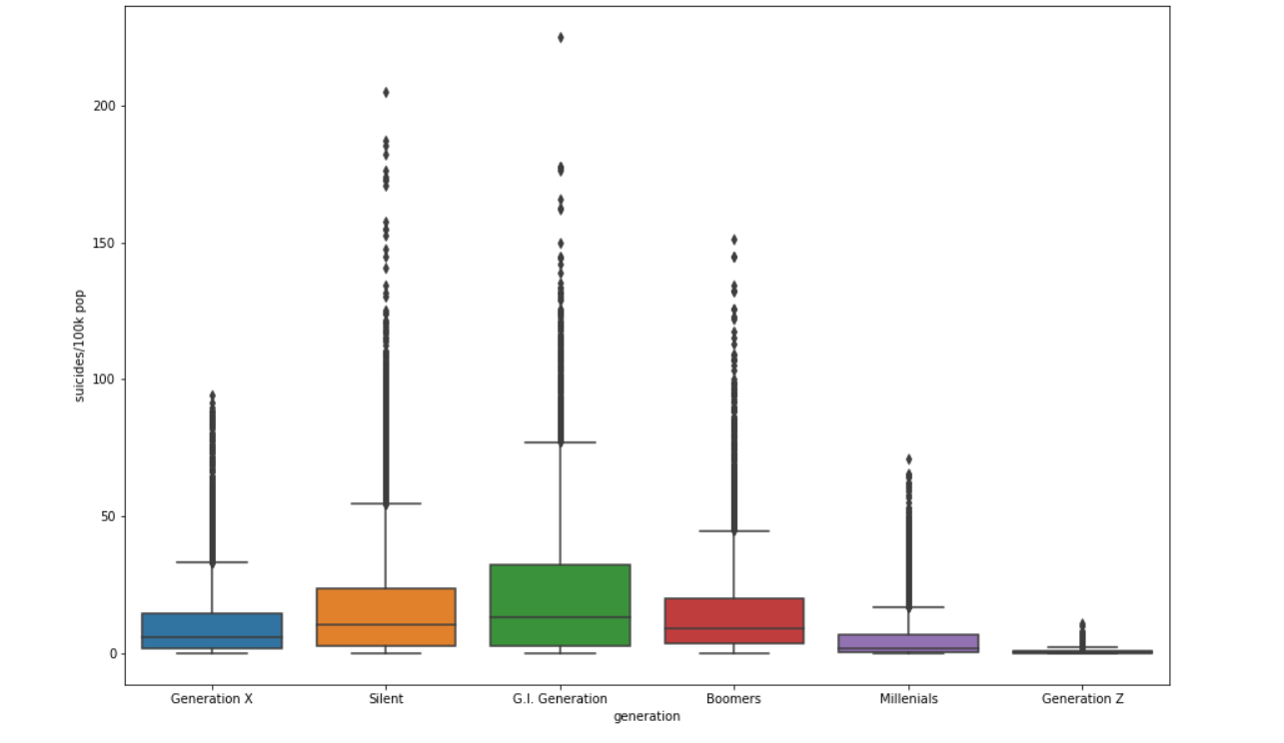
Cont..

Slide 10

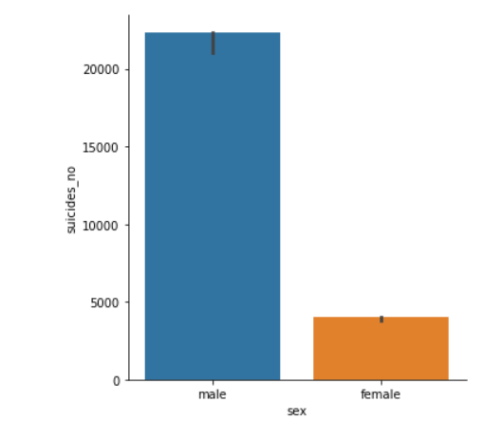
Contd..

Slide 11
Insights
The suicide rate for men is drastically high.
No matter the age group, there are many common reasons for suicide.
Saint Kitts and Nevis and Dominica both have 0 suicide cases.
The highest no of suicides are in the Russian Federation.

Slide 12
Learnings from the project
Graphical plotting.
Little more confidence for coding.
Getting outputs from similar variables.
Group by.
List.
Value counts.
Adding images to python.

Slide 13

Unanswered questions
Using loc and iloc function in our dataset
Creating heat map.

Slide 14
GitHub links
https://github.com/sharanjit13/Python
https://github.com/Parth6612/Python-Project

